Slide 1
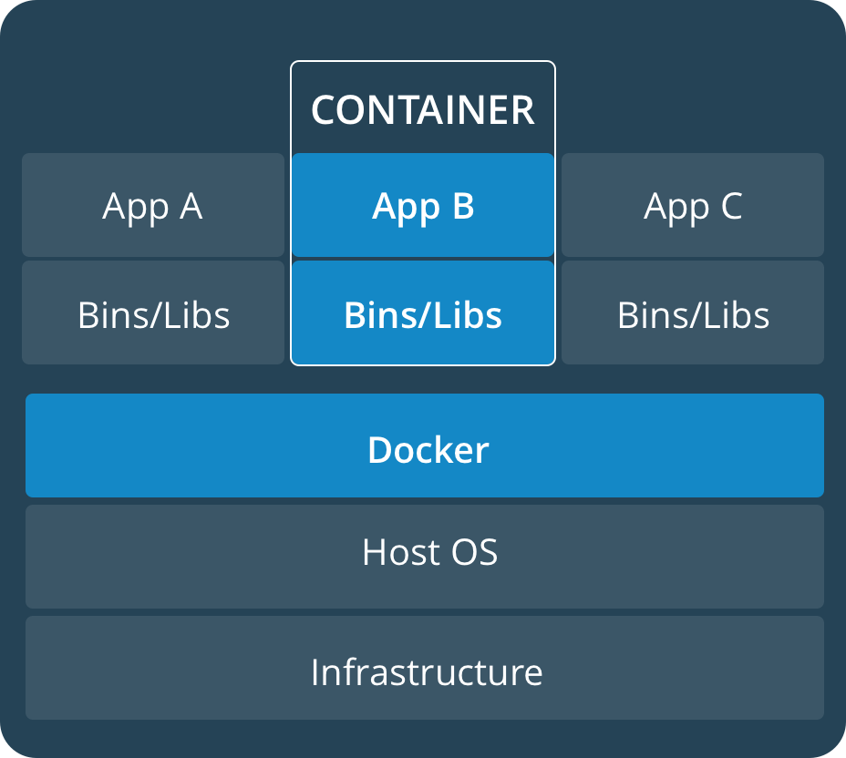

Real-time containerized applications Project phases
Determine system configuration, OS, RT-patch and engine
Evaluate latencies with different configurations in different settings: Bare metal, virtualized with direct hardware access (C5), virtualized standard instance
Develop a monitoring Framework, Benchmark
Setup a static schedule for a set of RT-applications to run in containers distributed on the available vCPUs
Develop a small specialized uni-kernel for the containers (depends on Docker support)
Elaborate dynamic scheduling algorithms for the same purpose and implement them in an orchestration service that runs in a separate container and manages the running applications

Slide 2
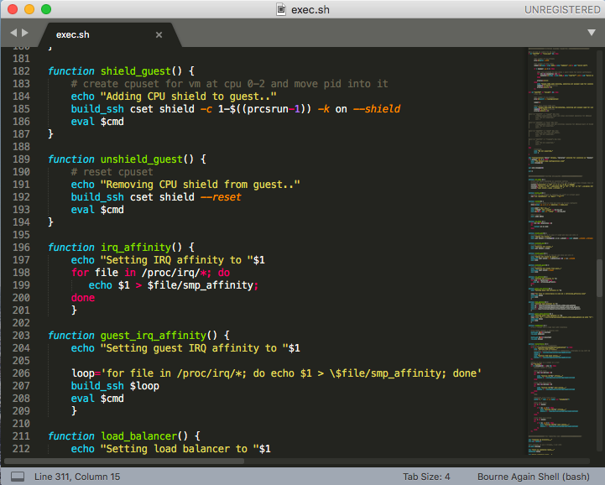

Performed steps
Identification of configuration, guest OS and kernel patch, + automatic test script
Basic and migration tests with container Engines and RT run configuration, run on bare-metal, AWS T3 and AWS C5
Paper revised, additional tests, documenting the feasibility evaluation of migrating from bare metal to a virtualized IAAS infrastructure, ICAC 2019
Recreated images with newer OS versions and patches for performance comparison and endurance tests (Ubuntu 18.04 LTS)
Selected and deployed monitoring system, Icinga
Ideation of a static offline schedule for a set of RT tasks per CPU, configuration and run of such schedule using dummy counting instances (rt-app)

Slide 3
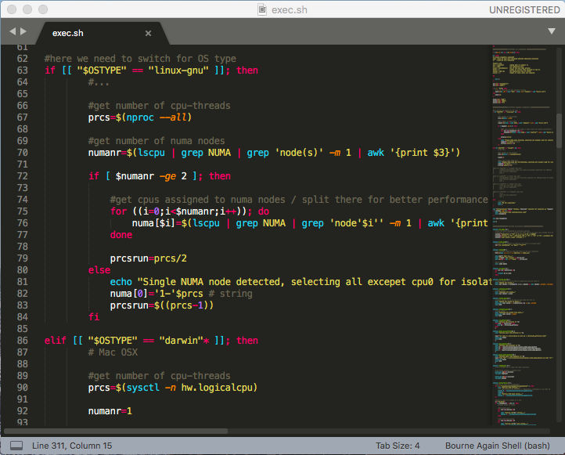
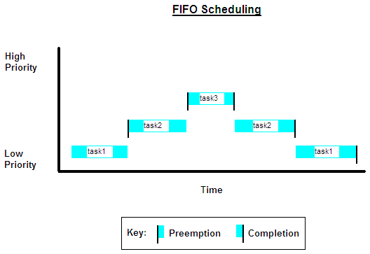
Progress (now)
Creation of a simple orchestrator, application running in the same container space -> IPC
(done) Process detection and listing
(done) tests variation of scheduling parameters of running processes via orchestrator
(done) tests process detection and simple parameter variation on a bare-metal 16 container (rt-app) instance
(ongoing) Integration of configuration file support
(ongoing) Integration of round robin algorithm for resource distribution based on U_{L} (utilization limit)
Creation of a monitoring plugin for Icinga to parse real-time data
(done) Plugin template tests
(done) parsing and output tests with rt-app
(ongoing) Log parsing and data transmission (requires changes in rt-app)
Study of Symmetric MultiProcessing (SMP) Hard-real-time literature and algorithms (research status)

Slide 4

Future steps
Configuration of a new test suite (script) for endurance tests and more detailed evaluation of overshoots: Comparison Bare Metal vs. AWS T3 vs. AWS C5
Comparison of results and evaluation of possibilities
Conclusion of paper 2, publication of results latency and performance, soft/ hard limits evaluation, venue TBD
Introduction of dynamic SMP scheduling based on the standard EDF and CBS-GRUB algorithms
Extension of the orchestrator, dynamic, performance oriented scheduling for the EDF case

